Slide 1
NACEL 2025 Figures Data Pack
Updated: 12.06.2026

Slide 2
NACEL Dataset (2018-2025)
Acute and Community Hospital Audit
Data collection is open for NACEL 2026 - reviewing care delivered in hospitals from January - December ‘26

Slide 3
NACEL 2025 Variation
Average Case Note Reviews submitted in 2025 was 83 vs 87 in 2024
Notes:
Average Case Note Reviews submitted in 2025 was 83 vs 87 in 2024
Site Breakdown
For Acute sites, the average Case Note Reviews submitted in 2025 was 97 vs 101 in 2024
For Community sites, the average Case Note Reviews submitted in 2025 was 38 vs 39 in 2024

Slide 4
NACEL 2025 Variation
Average Bereavement Surveys submitted in 2025 was 25 vs 30 in 2024
Notes:
Average Bereavement Surveys submitted in 2025 was 25 vs 30 in 2024
Site Breakdown
For Acute sites, the average Bereavement Surveys submitted in 2025 was 32 vs 38 in 2024
For Community sites, the average Bereavement Surveys submitted in 2025 was 4 vs 4 in 2024

Slide 5
NACEL 2025 Proportions
Acute vs Community
(149/174)
(139/158)
(10/16)
Target = 90% of sites submitting a minimum of 20 CNRs each quarter, 80 per year
Notes:
Interpretation Example (National):
There were 174 total sites that reported having at least 80 eligible deaths. Of these sites, 86% (149) submitted at least 80 Case Note Reviews.

Slide 6
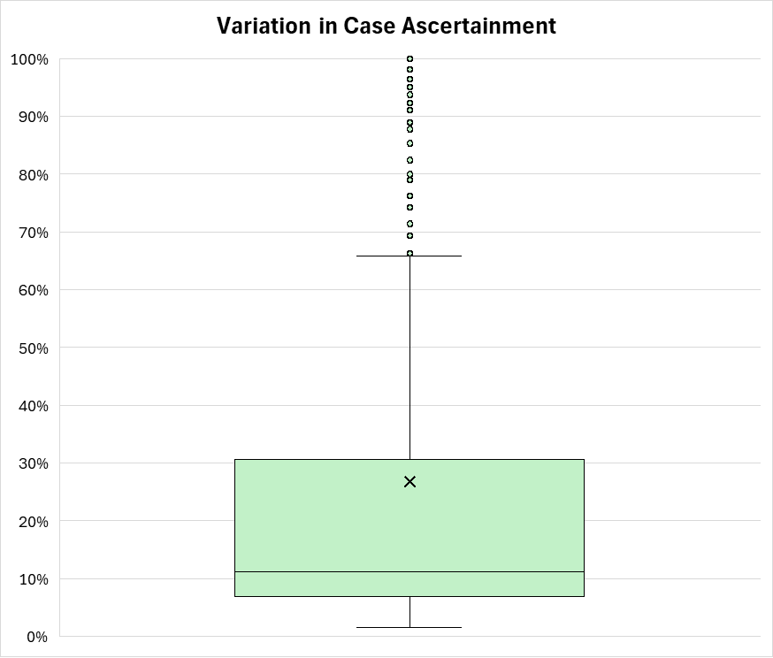
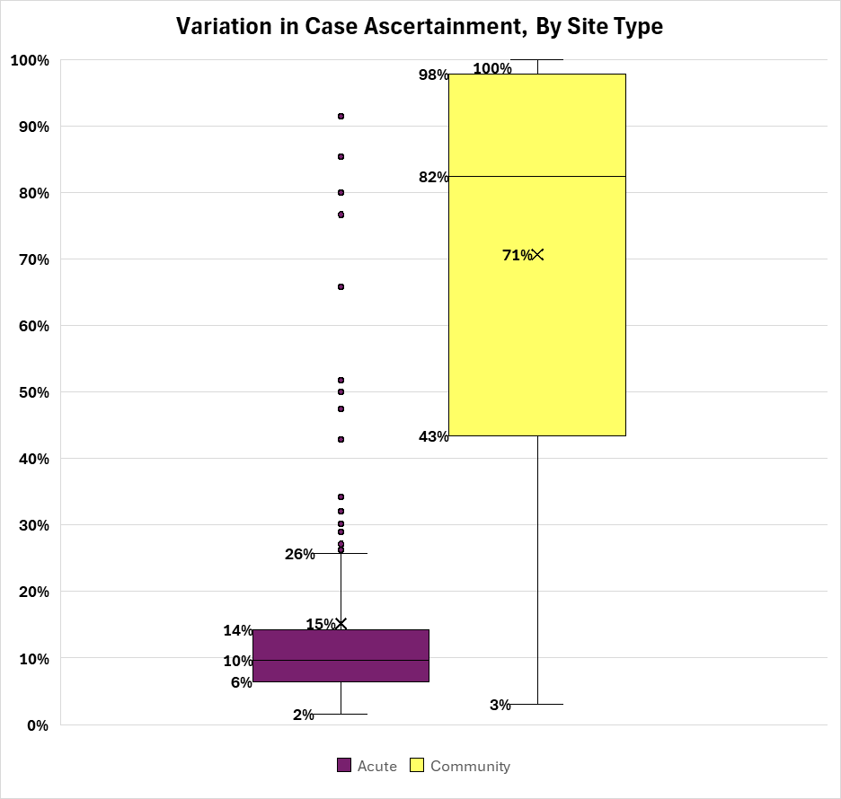
NACEL 2025 Case Ascertainment
66%
31%
27%
11%
7%
2%
Not included in charts above: 2 submissions had a 0% case ascertainment.
They were community submissions.
X = Mean
Notes:
Interpretation Example (National):
7% = Lower quartile (25th) = 25% of the data equals or falls below this value.
31% = Upper quartile (75th) = 25% of the data equals or falls above this value.
50% of organisations fell in between these = Interquartile Range (IQR)
27% = mean
11% = median
The dots represent the data that are considered outliers. The whiskers (3% and 36%) are the maximum and minimum data points that are not considered outliers.
Mean > Median = The mean (27%) is higher than the median (11%). It suggests the data is skewed upward - there are some higher values pulling the average up (distribution likely right-skewed).
Mean < Median = If the mean was 8%, so lower than the median (11%), then it would suggest that the data is skewed downward - there are some lower values pulling the average down (distribution likely left-skewed).

Slide 7
Summary
Dataset (2018–2025): In 2025, 19,705 Case Note Reviews, 5,994 Bereavement Surveys, 14,406 Staff Reported Measures, and 232 Hospital/Site Overviews were submitted — continuing the strong growth seen since 2018
Case Note Review (CNR) submission: The average number of CNRs submitted per organisation was 83 in 2025, down slightly from 87 in 2024, with notable variation across submissions
Bereavement Survey submission: The average number of Bereavement Surveys submitted per organisation was 25 in 2025, down from 30 in 2024, with wide variation and many submissions receiving zero responses
CNR submission target (≥80 CNRs): 86% of national sites who had at least 80 annual eligible deaths (149/174) met the target for submitting ≥80 CNRs. Acute sites performed strongly at 88% (139/158); community sites were below target at 63% (10/16). The national target is 90%
Case ascertainment: The national mean was 27% (IQR 11%–31%, upper whisker 66%). Community sites showed considerably higher ascertainment (mean 71%, IQR 43%–82%) than acute sites (mean 15%, IQR 10%–26%). Two community submissions recorded 0% meaning they had zero eligible deaths in 2025
Bereavement Survey engagement: 67% of all submissions (157/236) received at least one response. Of those reporting participation via the Annual Death Data Collection, 77% (165/214) participated in the Bereavement Survey, and 88% of that group (145/165) received at least one response.

